Slide 1

EMPLOYEE MANAGEMENT SYSTEM

Slide 2
Problem Statement
Role-based application.
2 roles: Admin and Employee.
Purpose of this application is to provide the ability to Search, Add, Edit and Delete the employee details as an admin.
The Employee can only have the read-only access to view the employee details

Slide 3
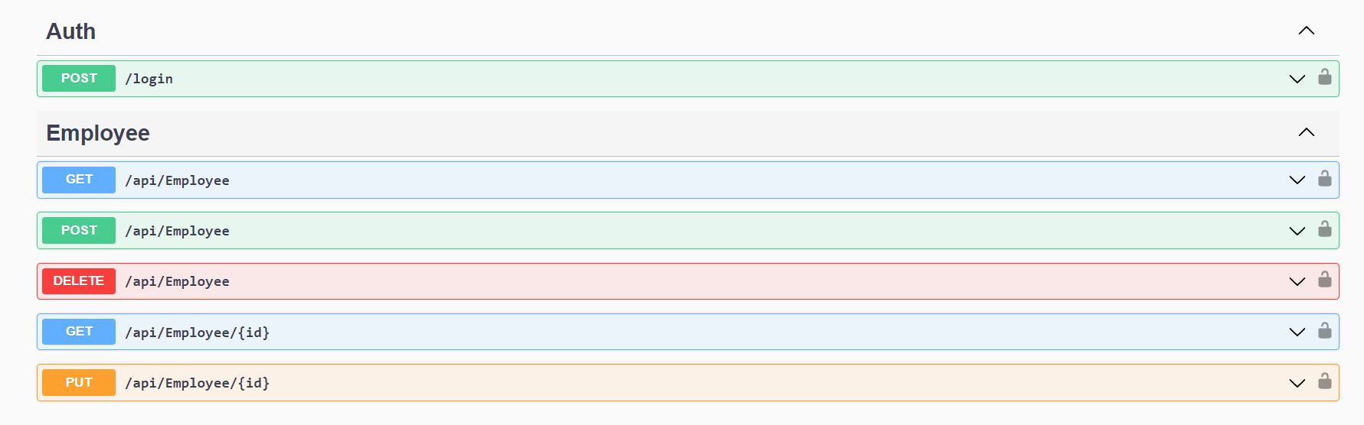
Rest APIs

Slide 4
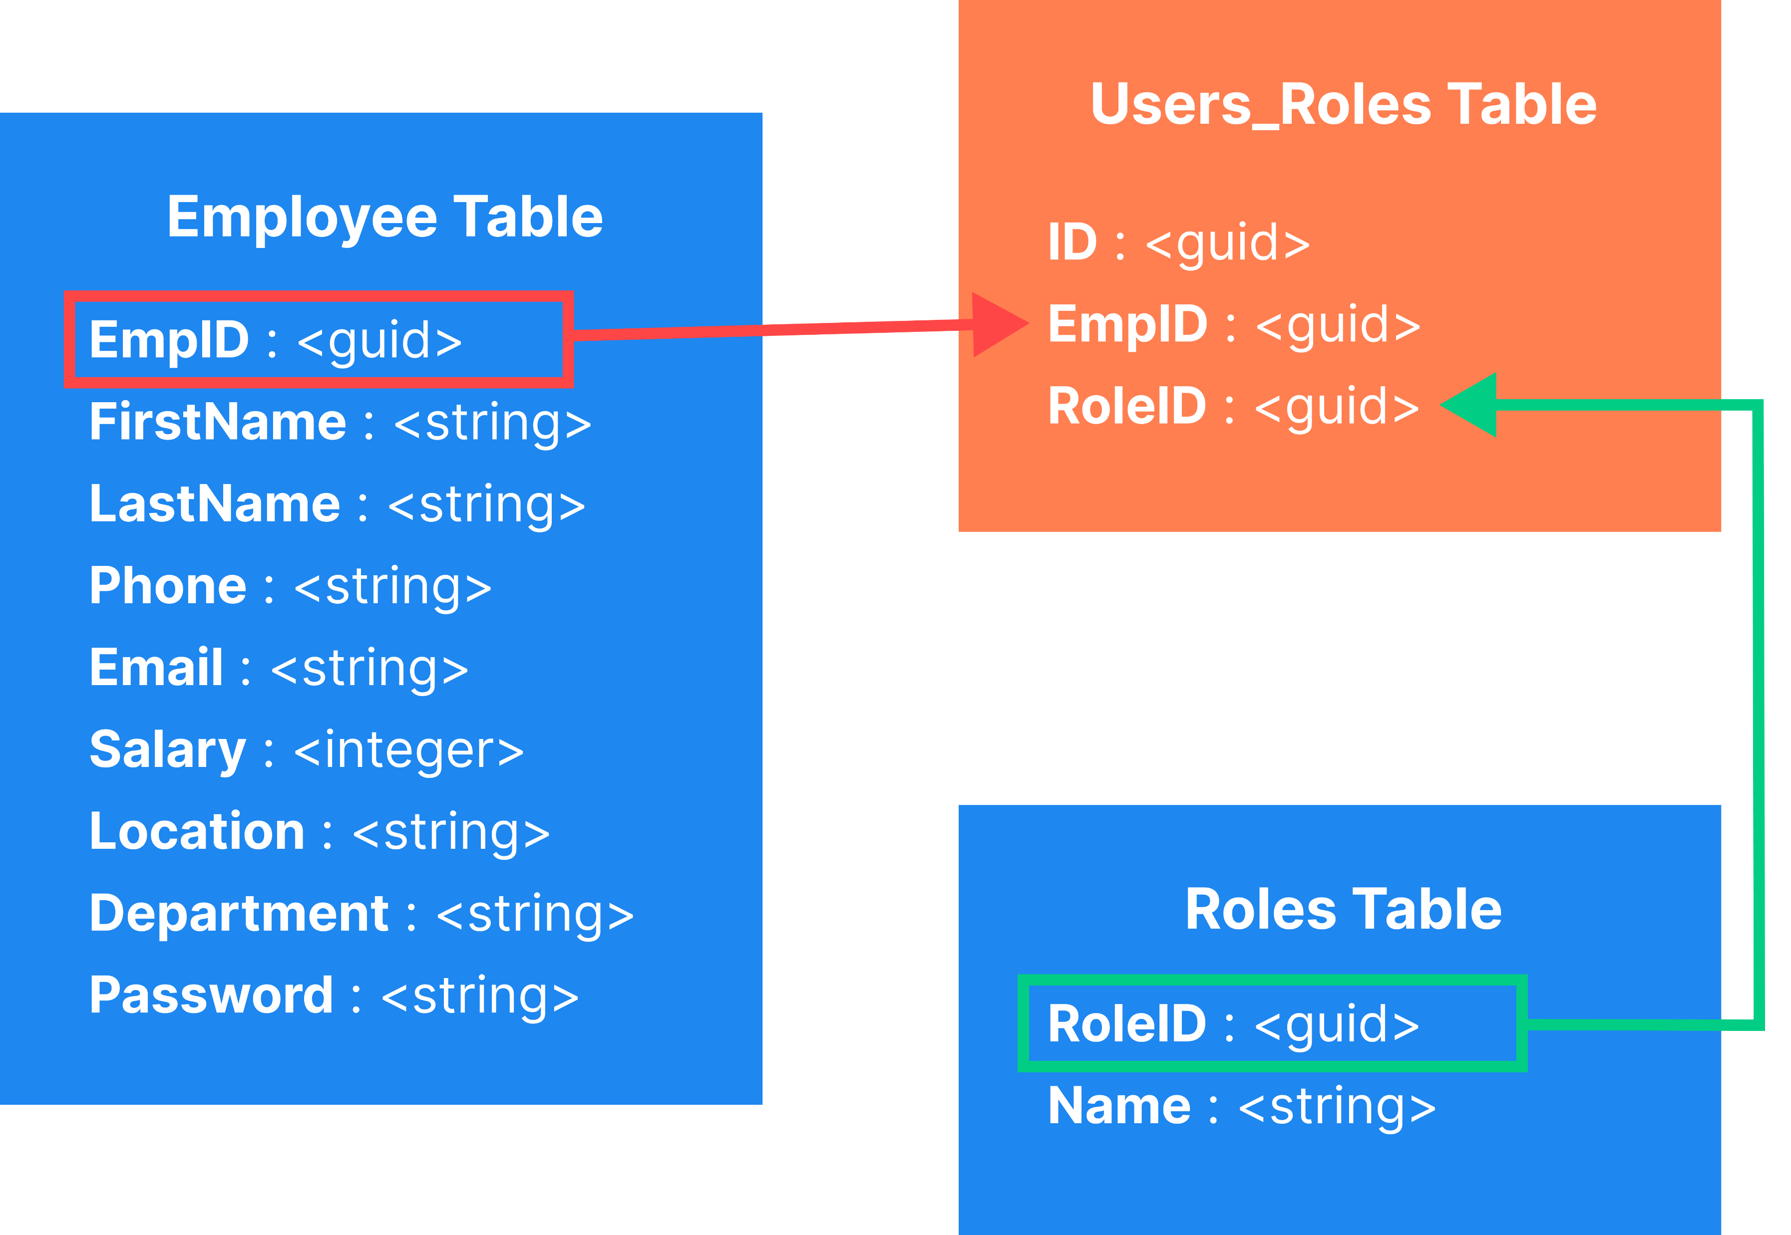
Database Representation

